Slide 1
Concurrency — Exercise 5
Locking 2

Slide 2
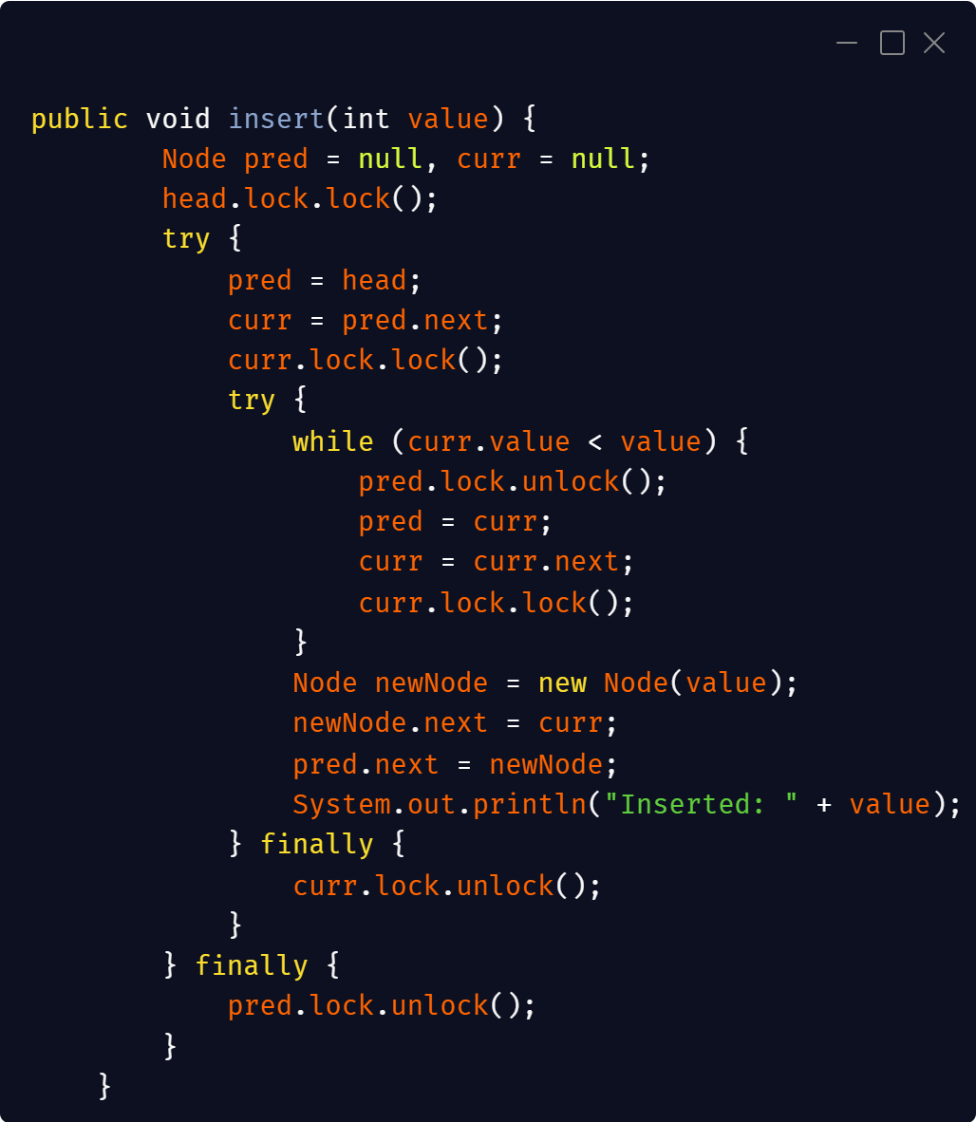
Problem 1

Slide 3
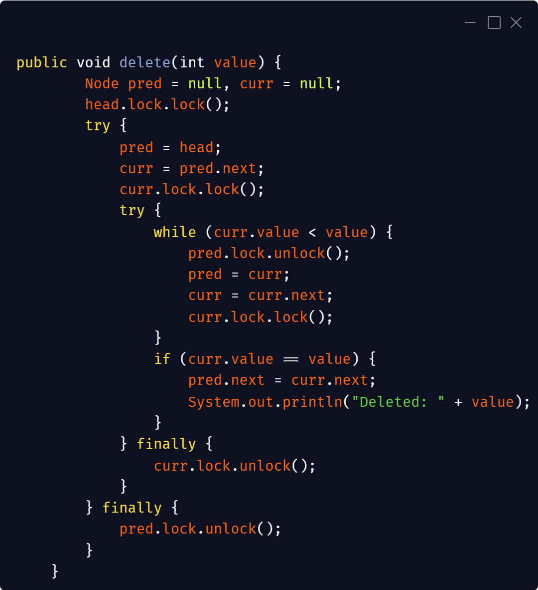
Problem 1

Slide 4
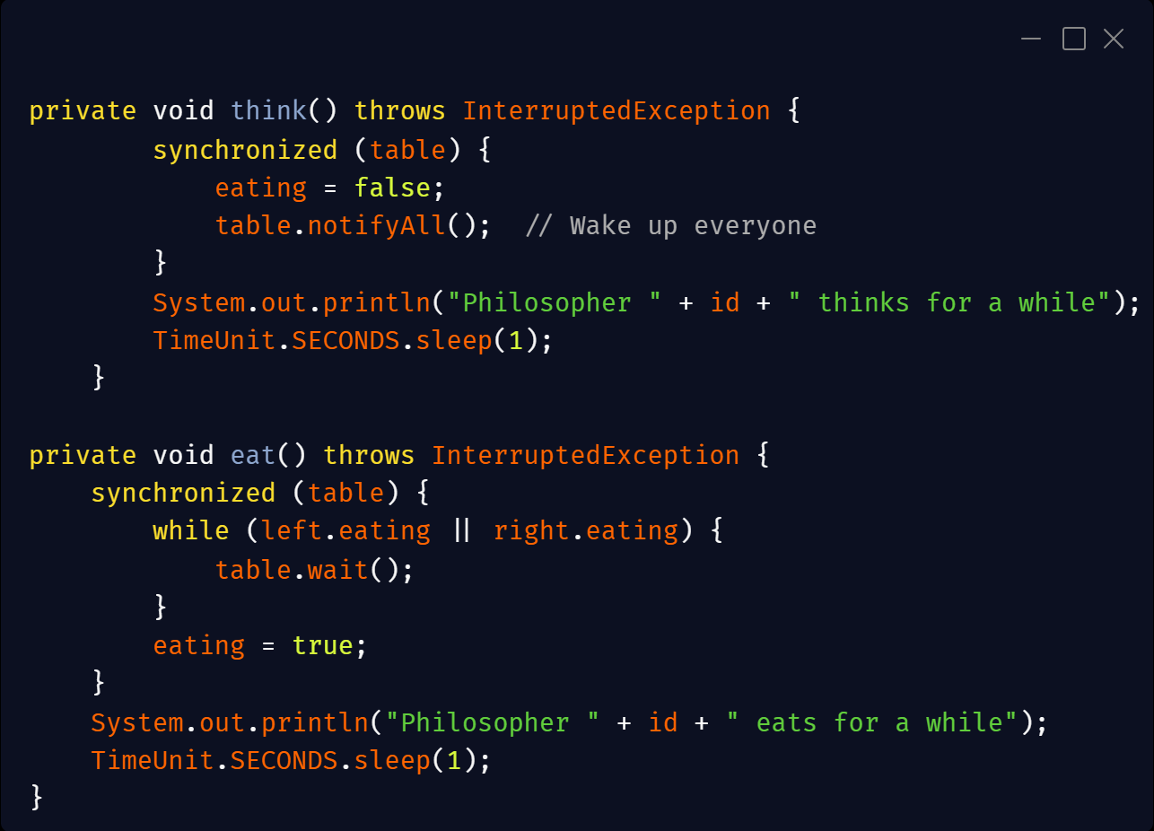
Problem 2

